Slide 1
Blueprint Basics

Slide 2
What are Blueprints?
Blueprints are a visual scripting system in Unreal Engine, used for creating game logic and interactions without traditional text-based programming.
They enable developers and designers to create complex functions through a node-based interface.
Ideal for prototyping, quick iterations, and for those without extensive programming experience.

Slide 3
Blueprints vs. C++ in Unreal Engine
Blueprints offer a more intuitive, visual approach compared to C++'s text-based coding.
While C++ can be more efficient for complex and performance-critical tasks, Blueprints are excellent for rapid development and testing.
Many projects combine both, using C++ for core functionalities and Blueprints for level design and gameplay elements.

Slide 4
Viewport, Construction Script, Event Graph
The Viewport is where you can view the object you are cresting the view port for.
The Construction Script is a blueprint graph. This is where you would store blueprint logic that happens before the game starts
The Event Graph is where you store all the blueprint logic when the game starts or when the game is currently running.

Slide 5
Basic Components of Blueprints
Nodes: The basic building blocks of Blueprints, representing functions, events, and operations.
Wires: Connect nodes to define the flow of data and execution order.
Variables: Store and manipulate data within a Blueprint.
Events: Trigger actions in response to specific occurrences in the game world.

Slide 6
Let’s Create your first Blueprint!
How to Grab an Object in Unreal Engine 5

Slide 7
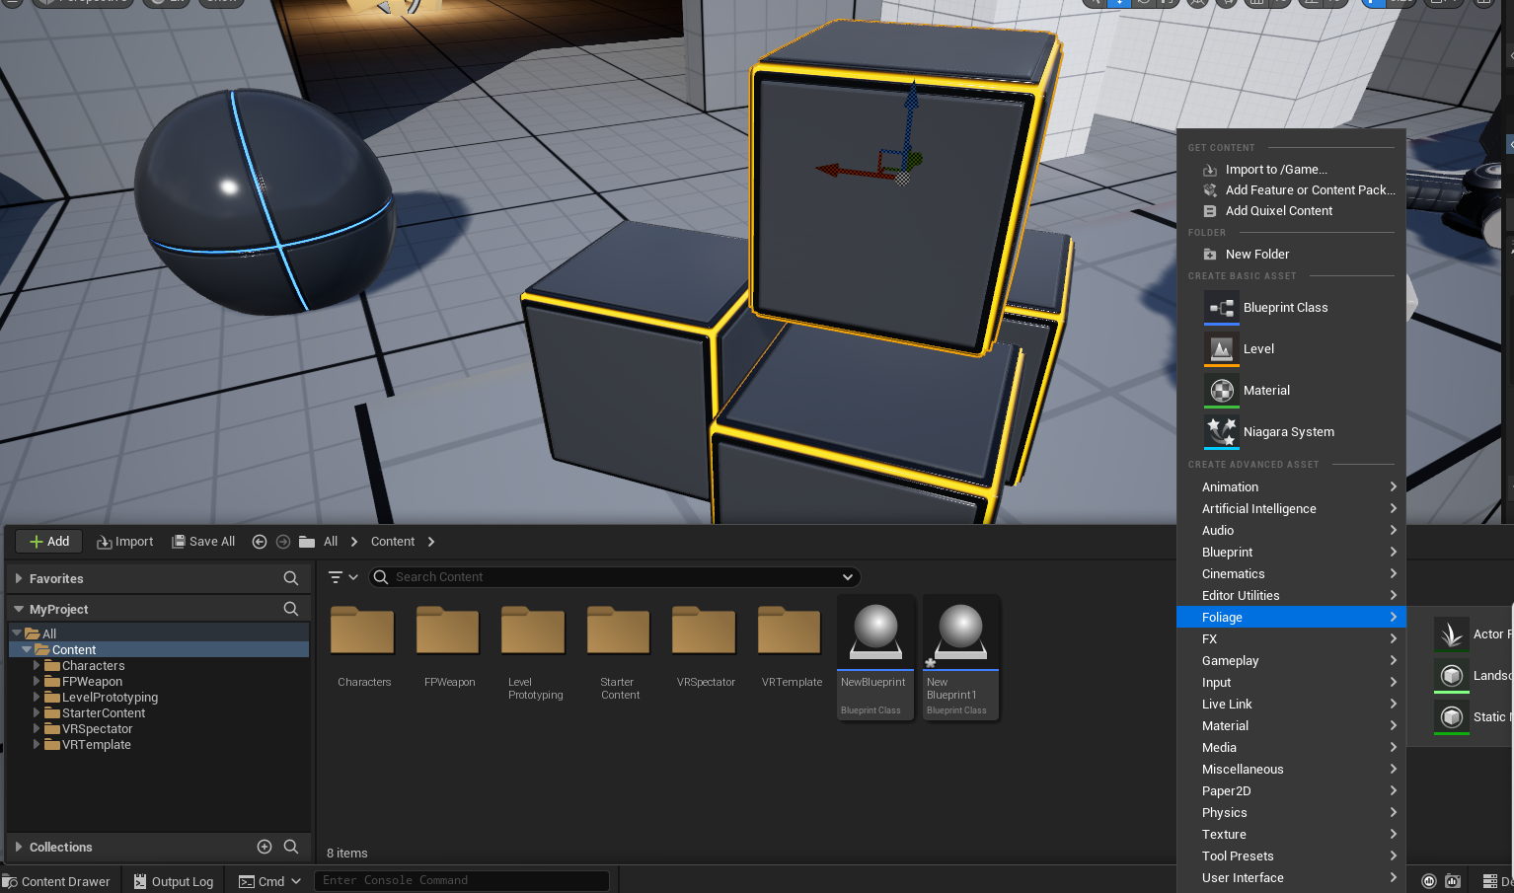
Step 1: Click on content folder
Right click on an empty area
A menu should pop up to the right.

Slide 8
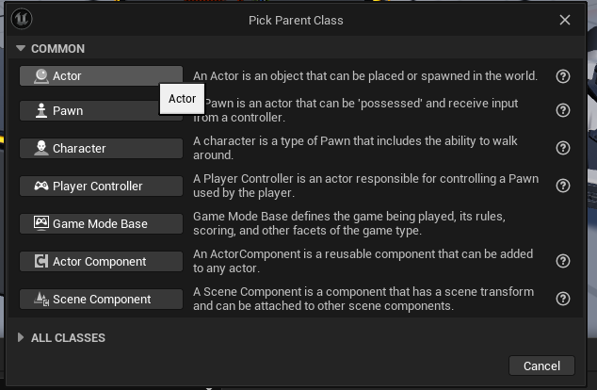
Step 3: Right click and open up new BluePrint
A text box will pop-up and make sure to click Actor. Then feel free to name the blueprint object anything you’d like.

Slide 9
Step 2: Import Shape
If you would like to use the shapes that is already provided in Unreal Engine 5, you can simply drag and drop it into the menu section and same goes for if you import a 3D Model.
Tip: If you want to import a certain shape you must download the 3D model. Some websites to use for 3D objects would be:
https://sketchfab.com/
https://www.cgtrader.com/

Slide 10
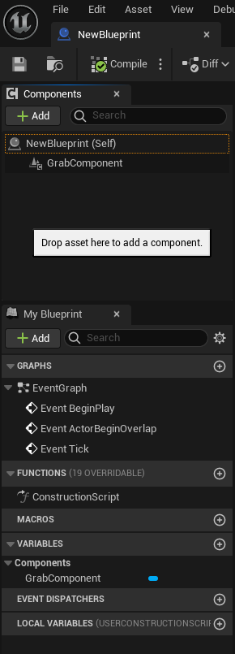
Step 4: Attaching GrabComponent to object
Double click on your new blueprint. On the left hand side there is a section calle components. Here you can search for the grab component and attach it to.
If you have imported an object where it says NewBlueprint (Self) to the right should be where your object is.

Slide 11
Step 5: Save and press play
That is all! Feel free to play around with the setting of the objects.

